Slide 1

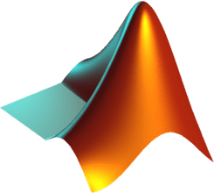
WORKFLOW

Slide 2
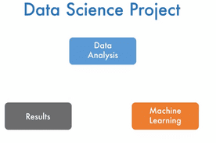

Slide 3
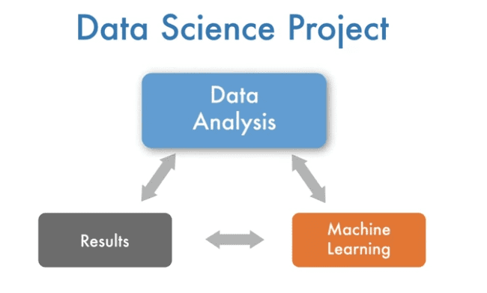

Slide 4
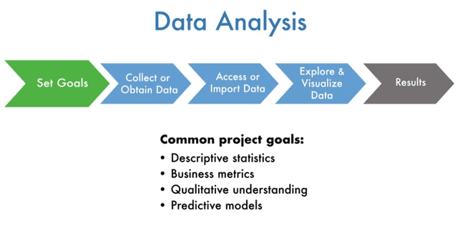

Slide 6
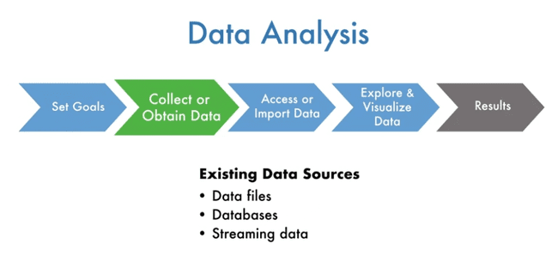

Slide 7
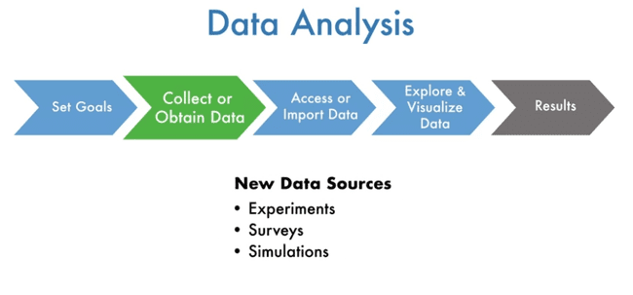

Slide 8
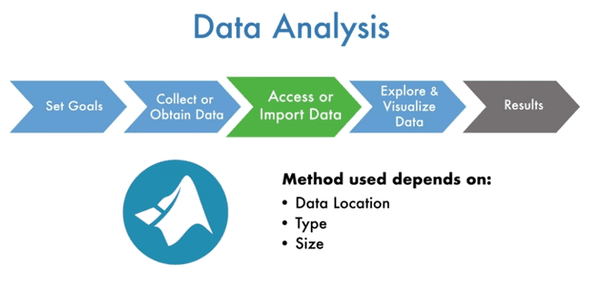

Slide 9
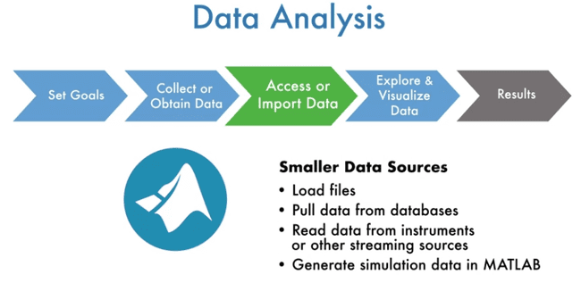

Slide 10
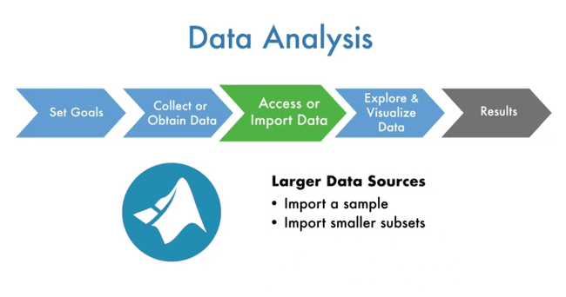

Slide 11
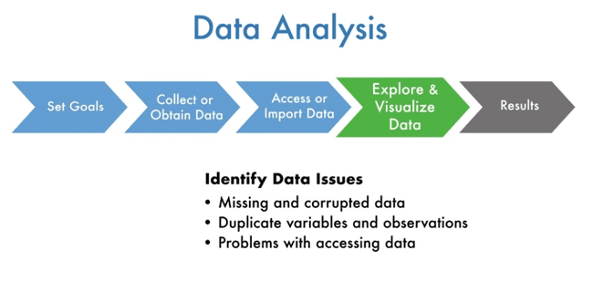

Slide 12
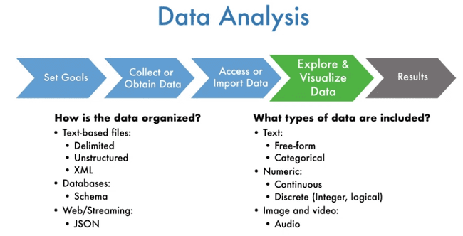

Slide 13
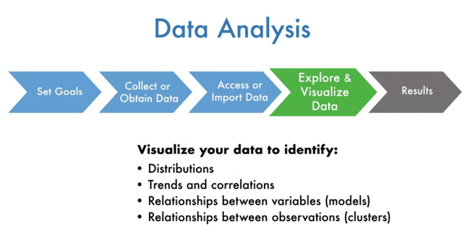

Slide 14
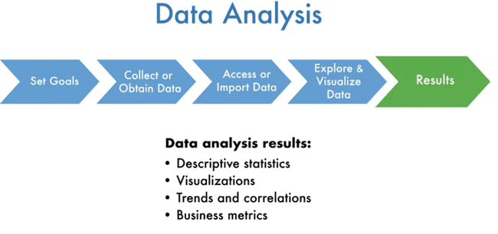

Slide 16
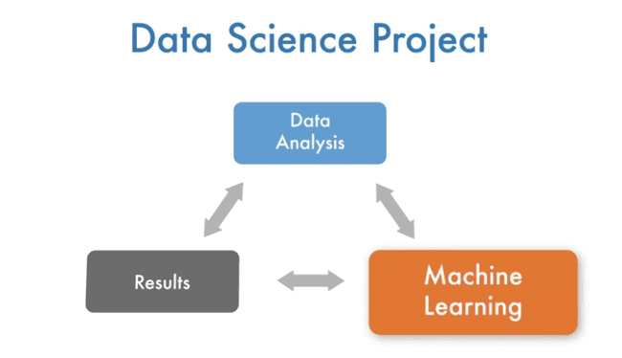

Slide 17
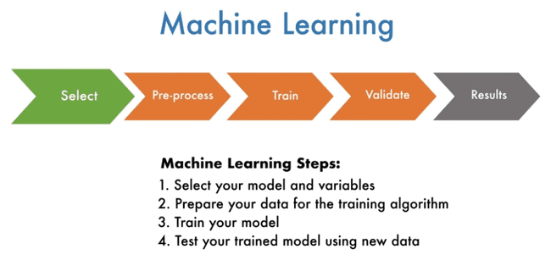

Slide 19
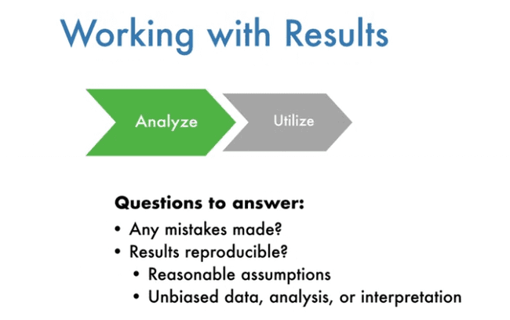

Slide 20
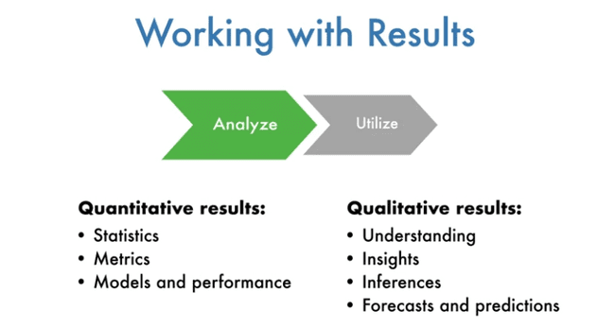

Slide 21
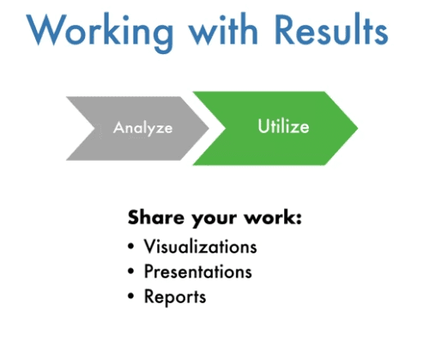

Slide 22
Exploratory data analisis

Slide 23
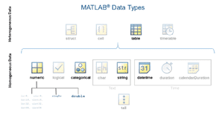

Slide 24
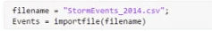
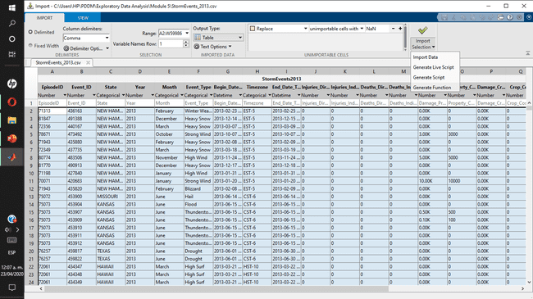
uiimport (‘.formato’) - importar
Day year month as a function of datatype
Linspace()
Summary()
Std(,’omitnan’)
Corr()
Groupsummary
Summary

Slide 25
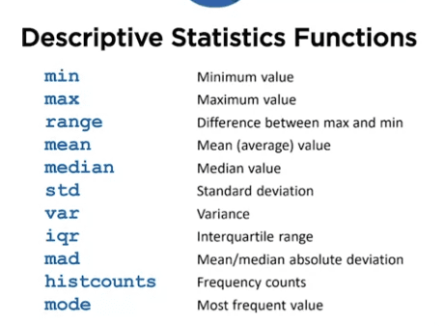

Slide 26
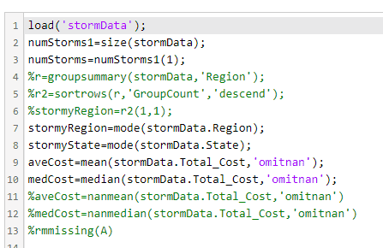
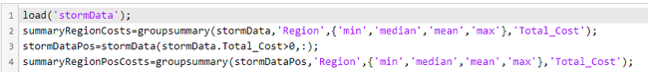

Slide 27
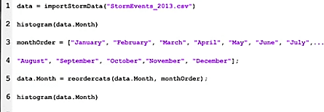
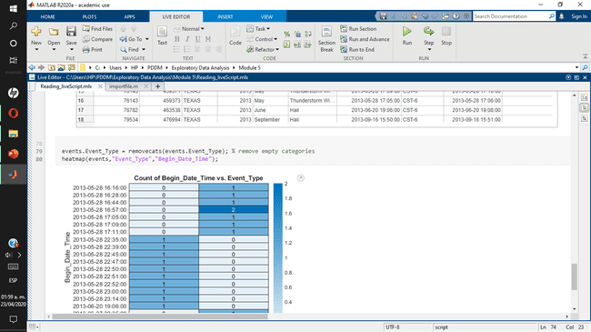

Slide 28
Geobasemap(‘’colorterrain)
Geodensityplot()
head or tail function
Geoscatter
Linspace
Logspace
sort

Slide 29
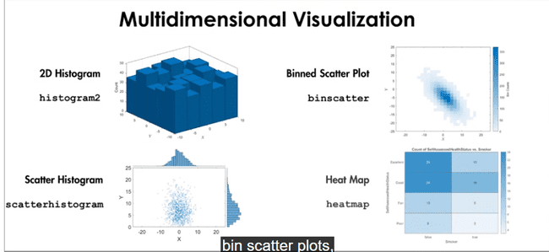

Slide 30
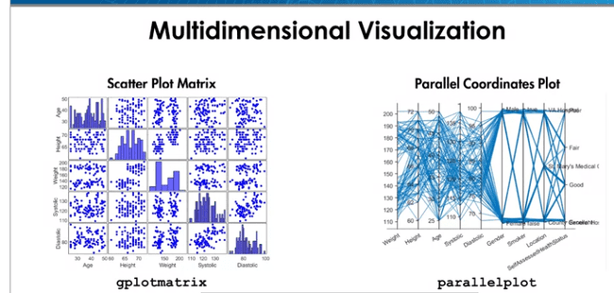

Slide 31
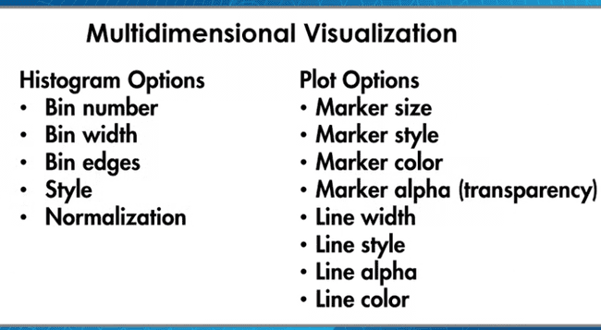

Slide 32
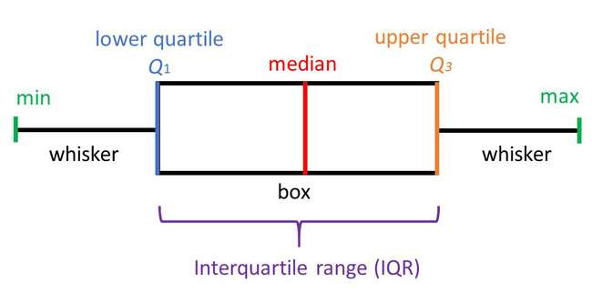

Slide 33
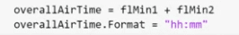
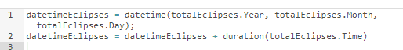
Extractbetween()
Erase()
Unique()
Replace()
Contains()
Characters and strings
Duartion()
calendarDuration()
Datetime()
Dates and times
Variable.”hour,day,minute,second,month,Year “
caldays, calweeks, calquarters, and calyears, calmonth s

Slide 34
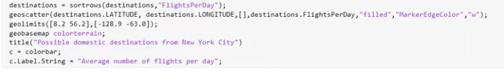
fdata=datastore("flights*.csv");
flall=readall(fdata)
Join()
Innerjoin()
Outerjoin()

Slide 35
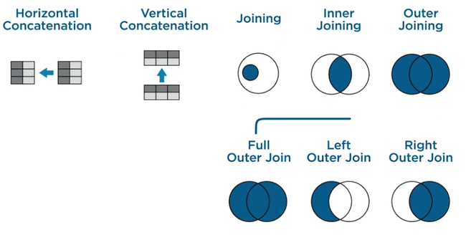
Join
Innerjoining
Outer joining

Slide 36
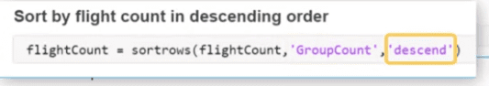
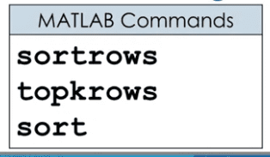
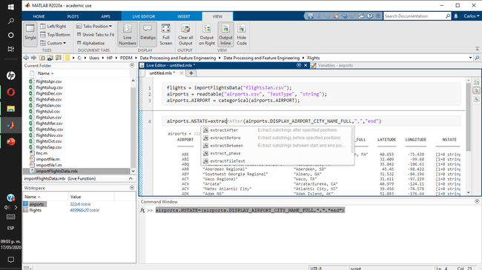

Slide 37
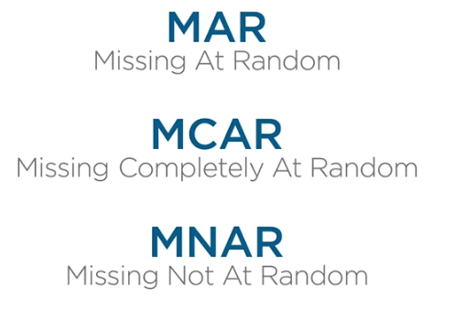

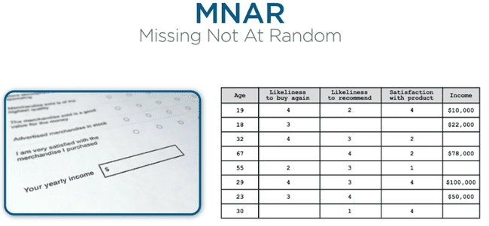
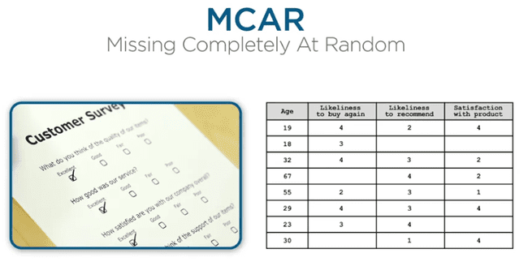

Slide 38
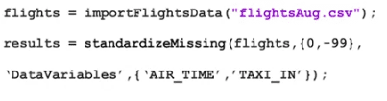

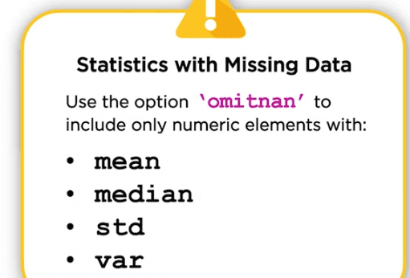
nnz

Slide 39
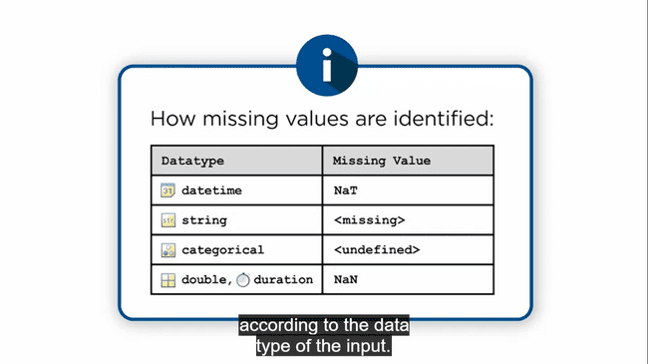
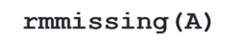
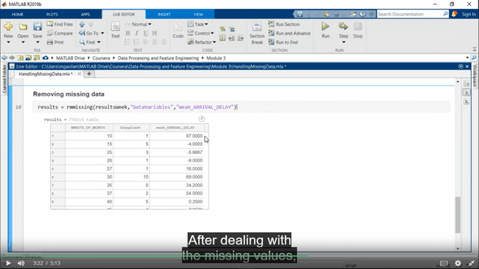
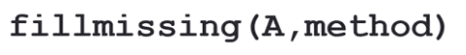
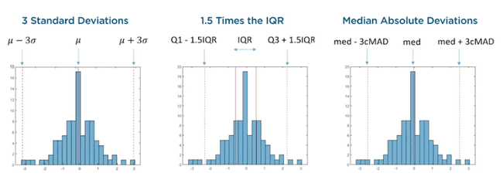

Slide 40
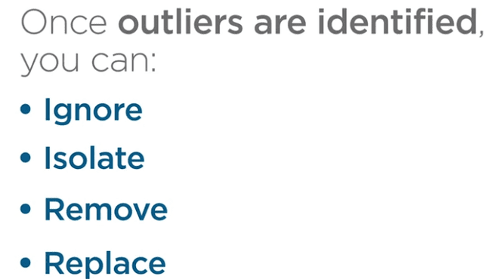
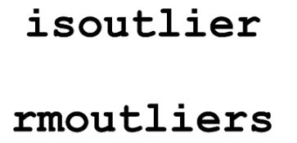
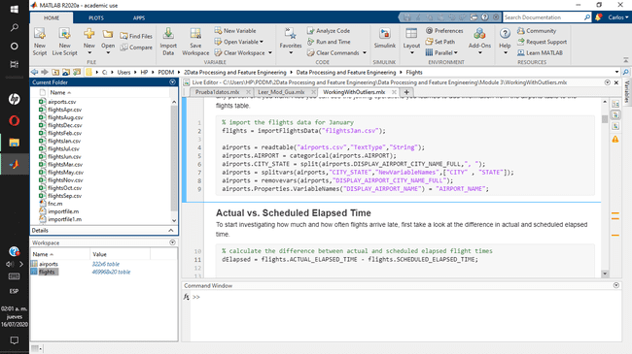

Slide 41



Slide 42



Slide 43



Slide 44




Standarization

Slide 45




Slide 46




Slide 47



Solo aplica en una distribución normal, usa pruebas estadísticas para aceptar rechazar esto

Slide 48






Slide 49



Slide 50
1 Análisis de datos, se visualiza, según el caso se remueven outliers y ruido
2 Se normalizan los datos para poder ser comparados

Slide 51

A feature is a piece of information in your data that is meaningful to the problem you're trying to solve. It's what you'll use to teach or train your model to make predictions. The process of transforming your data into features is called feature engineering.
A feature is a property of whatever you are trying to describe
A collection of individual features forms a single observation and a collection of individuals observations forms a dataset
These features as a predictor as predictor variables in a model

Slide 52



Theoretically, you can generate an infinite number of new features but only a limited few will actually be useful.

Slide 53


Theoretically, you can generate an infinite number of new features but only a limited few will actually be useful.

Slide 54




Slide 55


Discretizacíon:
Proceso de transferir funciones continuas, modelos, variables y ecuaciones a contrapartes discretas
La dicotomización es el caso especial de discretización en el que el número de clases discretas es 2, que puede aproximar una variable continua como una variable binaria

Slide 56



When creating features, data scientists often start by looking for
relationships in their data.
Relationships enable them to predict the value of one variable based on the value of another

Slide 57




Slide 58


Slide 59


Slide 60




Slide 61



Slide 62




Slide 63



Visualizar cada variable por separado
stackedplot(X);

Slide 64


Se modifica el valor del cluster, se mide el ajuste para después verificar con la media
Esto se hace de forma manual

Slide 65

Forma automática de evaluar los cluster
Dado un rango de operación

Slide 66



Slide 67


Slide 68


Slide 69





Slide 70



Slide 71





Slide 72



Varianza
Es la media de las diferencias con la media elevadas al cuadrado.
es un índice muy sensible a las puntuaciones extremas. Mide la dispersión que representa la variabilidad de una serie de datos respecto a su media
Valor escalar positivo
N=0 – Indica nulo cambio
N>>0 – Indica alta dispersión
Desviación estándar
La Desviación Estándar mide cuánto se separan los datos. Su símbolo es σ (la letra griega sigma en minúscula).
La fórmula es fácil: es la raíz cuadrada de la Varianza. Así que, "¿qué es la Varianza?"

Slide 73


Covarianza
Valor que refleja en qué cuantía dos variables aleatorias varían de forma conjunta respecto a sus medias.
C(X,Y) <0 “X” sube “Y” baja. Hay una relación (-)
C(X,Y) >0 “X” sube “Y” sube. Hay una relación (+)
C(X,Y) =0 no hay relación existente entre las variables “X” “Y”.
Correlación
Asociación entre dos variables numéricas, específicamente evalúa la tendencia (creciente o decreciente) en los datos.
-El signo nos indica la dirección de la relación.
-La magnitud nos indica la fuerza de la relación,
La correlación de 1 o -1 la correlación es “perfecta”,
La correlación vale 0 las variables no están correlacionadas.

Slide 74





The strength of the linear relationship between a continuous feature pair X and Y can be evaluated by computing their correlation coefficient

Slide 75


Kendall also uses ranks, though a different formula is used to calculate the coefficient
.
Kendall is preferable to Spearman (and Pearson) in situations where the dataset is small and/or there are likely to be many ties in rank due to identical data values.
Pearson correlation describes the strength of the linear relationship between two features
To indicate a potential nonlinear relationship. A different correlation measure, Spearman's rank correlation, may provide a more reliable indicator of relationship strength in these situations,
Spearman correlation is actually computed using the same formula as Pearson's correlation. However, the features are first ranked in order of smallest to largest value, and the feature ranks are used in the correlation formula instead of the values.
Spearman correlation can be used to evaluate predictor-response pairs where one or both is discrete

Slide 76


This method of feature generation is referred to as "one-hot encoding“:
Converting each categorical variable into two or more logical features - one new feature for each category - then computing the correlation between each new feature and the response.
Converting non-numeric data into binary numeric features

Slide 77


Tabla de contingencia

Slide 78


La prueba chi-cuadrado es utilizada para analizar variables nominales o cualitativas, es decir, determinar la existencia o no de independencia entre dos variables. Que dos variables sean independientes significa que no tienen relación, y que por lo tanto una no depende de la otra, ni viceversa.
used to compute a statistical measure of the dependence between two features. The chi-squared statistic of two features is calculated by computing the difference between the observed and expected count for each category pair, dividing by the expected count, and summing over all pairs:
Valor observado (obtenidos) y valor esperado (este se calcula)

Slide 79


Slide 80



Es un método estandarizado para representar gráficamente una serie de datos numéricos a través de sus cuartiles.

Slide 81
The continuous feature value will be less helpful in predicting the group, as the value might conceivably belong to more than one group.
Predicting the continuous variable value - say by using the group mean or median - won't be much more accurate than if you predict the overall mean because the group mean is likely close to the overall mean
Predicting the group using the continuous feature value will result in errors as a significant number of observations could lie in one or more groups.
Using the group to predict the continuous value will result in larger errors as the large variance implies more values lie further from the mean/median.
These ideas can be quantified to describe the strength of the relationship between a continuous-discrete feature pair by computing their F-statistic.
.

Slide 82


The anova1 function can be used to perform an analysis of variance test in MATLAB using the continuous and discrete feature as inputs. The function returns a p-value as output and displays an 'ANOVA Table' that includes the F-statistic as well as a notched box plot for reference.
p = anova1(tbl.(x),tbl.(y))

Slide 83
It's important to reiterate that the p-value returned by a statistical test is the probability of obtaining the given test statistic from your data if the two features are independent.
This is not the same as the probability of the variables being independent
As a data scientist, it's important to focus on your goal of building a predictive model when evaluating features. Try to avoid drawing final conclusions about the dependence or independence of your features based on the results of statistical tests - leave that to the statisticians. Instead, focus on their relative value in terms of your model and the other features.
If a test indicates a predictor and response are independent due to a high p-value, then retaining that predictor will most likely not provide much predictive power.
If you are comparing multiple predictor features, then predictors with lower p-values will likely add more predictive power than features with higher p-values and should therefore be given precedence when selecting features.

Slide 84
Statistical test only provides an overall measure
This additional context can help guide feature evaluation and selection or lead you to engineer better features
It can also help you estimate model performance and anticipate potential issues where the predictive power of your feature set is lacking.
The visualizations used in this script (box plots, heatmaps, scatter plots) can provide you with this valuable information, and, when possible, it's recommended that you include these visualizations in your feature evaluation and selection workflow.

Slide 85




Slide 86



Slide 87




Slide 88



Slide 89



Slide 90

PCA should only be applied to continuous features
It is also necessary to organize the continuous features into a matrix
The features should also have 0 mean and possess similar scales
P:Coeficientes de componentes principales (matriz)
S: Puntuaciones de CP(Matriz) Filas a observaciones y columnas a componentes
V: Varianza del CP valores de matriz covarianza (vector)
[P,S,V] = pca(X)

Slide 91



Slide 92



Slide 93


fitgmdist
Ajustar el modelo de mezcla gaussiana a los datos
cluster
Construct agglomerative clusters from linkages
jet
Jet colormap array
statset
Create statistics options structure

Slide 94

tbl.Cluster = clst;

Slide 95



Slide 96


Slide 97



j

Slide 98
load bostemp.mat tempC
tempC
load officetemp.mat temp
temp
officeTemp = timetable(temp,'TimeStep',minutes(30))
exactTimes = datetime(2011,1,1,hoursJan,0,0)'
bostonTemp2 = timetable(tempC,'RowTimes',exactTimes)
bostonTemp3 = table(exactTimes,tempC);
bostonTemp3 = table2timetable(bostonTemp3)
bostonTemp.Time.Format = "d"
newBostonTemp = retime(bostonTemp,"regular","linear","TimeStep",minutes(30))
dailyHigh = retime(bostonTemp,"regular","max","TimeStep",days(1));
dailyLow = retime(bostonTemp,"regular","min","TimeStep",days(1));
syncTemp = synchronize(bostonTemp,officeTemp,"regular","linear", ...
"TimeStep",hours(1),"EndValues",NaN);
stackedplot(syncTemp);
title("Correct synchronize results")

Slide 99



Slide 100




Frequency analysis

Slide 101





Slide 102


Slide 103




Slide 104




Slide 105



Slide 106




Slide 107




Slide 108







Slide 109



Slide 110




Slide 111




imread(f);
size();
Imshow()
rgb2gray();
edge();

Slide 112


imread(f);
size();
Imshow()
rgb2gray();
edge();

Slide 113



sonnets = extractFileText("sonnets.txt")
% get the 18th sonnet
start = " XVIII" + newline;
fin = " XIX";
sonnet18 = extractBetween(sonnets,start,fin)
% Split using a double newline since these separate the sonnets
sonnetsChunks = split(sonnets,[newline newline])
% Look at the histogram of string lengths
sonnetChunkLengths = strlength(sonnetsChunks);
histogram(sonnetChunkLengths,10);
sonnets = sonnetsChunks(sonnetChunkLengths >= 300)
tokenizedSonnets = tokenizedDocument(sonnets)
wordcloud(tokenizedSonnets);
tokenizedSonnets = erasePunctuation(tokenizedSonnets);
tokenizedSonnets = removeStopWords(tokenizedSonnets);
tokenizedSonnets = lower(tokenizedSonnets);
wordcloud(tokenizedSonnets);

Slide 114




shakeStop = ["thy","thou","thee","thine","doth","hath","nor","dost","hast","art","o"];
tokenizedSonnets = removeWords(tokenizedSonnets,shakeStop);
wordcloud(tokenizedSonnets);
wordBagSonnets = bagOfWords(tokenizedSonnets)
wordBagSonnets.Counts(153,3042) wordBagSonnets.Vocabulary(3042)
tokenizedSonnets(153)
spy(wordBagSonnets.Counts);
plot(sum(wordBagSonnets.Counts))
top10words = topkwords(wordBagSonnets,10)

Slide 115


wordToSee = "beauty" ;
wordPos = wordBagSonnets.Vocabulary == wordToSee;
bar(wordBagSonnets.Counts(:,wordPos)); % visualize the result with a bar plot
xlabel("Sonnet");
ylabel("Appearances of ''" + wordToSee + "‘’”)
%analyze where and how a word appears
wordContext = context(tokenizedSonnets,wordToSee);
disp(wordContext.Context)
Normalize Words: This can be accomplished by lemmatizing or reducing the words to a root form ("loved" , "loves" , "love")
tokenizedSonnets = addPartOfSpeechDetails(tokenizedSonnets);
tokenizedSonnets = normalizeWords(tokenizedSonnets,"Style","Lemma");
wordBagSonnets = bagOfWords(tokenizedSonnets);
wordcloud(wordBagSonnets);

Slide 116




top5words = topkwords(wordBagSonnets)
bar(topWords,sortedWords.Count(1:nTop))
loveLoc = find(wordBagSonnets.Vocabulary == "love");
bar(wordBagSonnets.Counts(:,loveLoc));
nAve = 20;
loveDensity = movmean(wordBagSonnets.Counts(:,loveLoc),nAve );
hateDensity = movmean(wordBagSonnets.Counts(:,hateLoc),nAve );
plot(loveDensity/max(loveDensity))
hold on;
plot(hateDensity/max(hateDensity),'r');
hold off;
legend(["love","hate"],"Location","northwest")
xlabel("Sonnet");

Slide 117

rows2keep = events.Event_Type=="Hail" & ~ismissing(events.Cost) & strlength(events.Event_Narrative) > 0;
cols2keep = ["Event_Narrative","Cost"]; events = events(rows2keep,cols2keep);
events.Event_Narrative = replace(events.Event_Narrative,"-"," ");
documents = tokenizedDocument(events.Event_Narrative);
documents = erasePunctuation(documents);
documents = removeStopWords(documents);
documents = addPartOfSpeechDetails(documents);
documents = normalizeWords(documents,'Style','lemma’);
Un bigrama o digrama es un grupo de dos letras, dos sílabas, o dos palabras. Se utilizan en uno de los más exitosos modelos de lenguaje para el reconocimiento de voz. Un caso especial del N-grama. ayudan a proporcionar la probabilidad condicional de una palabra dada la palabra precedente
bag2 = bagOfNgrams(documents,"NgramLengths",2)
bag2.Ngrams
wordsBeforeSize = bag2.Ngrams(bag2.Ngrams(:,2) == "size",:)
wordsAfterSize = bag2.Ngrams(bag2.Ngrams(:,1) == "size",:)

Slide 118
bag3 = bagOfNgrams(documents,"NgramLengths",3)
wordsBeforeBallSize = bag3.Ngrams(bag3.Ngrams(:,2) == "ball" & bag3.Ngrams(:,3) == "size",:)
wordsBeforeDollarSize = bag3.Ngrams(bag3.Ngrams(:,2) == "dollar" & bag3.Ngrams(:,3) == "size",:)
wordsBeforePongSize = bag3.Ngrams(bag3.Ngrams(:,2) == "pong" & bag3.Ngrams(:,3) == "size",:)
searchWords = ["pea","dime","penny","nickel","quarter","halfdollar","pingpongball","golfball","billiard","tennisball","baseball" ,"softball", "grapefruit"];
bag = bagOfWords(documents);
To find the indexes of these words in the Vocabulary variable of the bag-of-words model, you can use the intersect() function.
[~,vocabOrder,searchOrder] = intersect(bag.Vocabulary,searchWords)
bag.Vocabulary(vocabOrder)
searchWords(searchOrder)
% reOrder describes the re-arrangement of the elements of searchOrder
[~,reOrder] = sort(searchOrder,"ascend");
vocabOrder = vocabOrder(reOrder)
bag.Vocabulary(vocabOrder)

